Slide 1
Email leakage prevention using Spark and Machine Learning
Mateusz Babiuch
Agnieszka Pocha

Slide 2
General Overview
What is the problem and why is it important?
What approach have we used?
What was our data?
Results

Slide 3

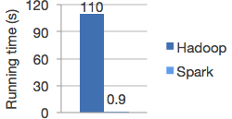
Fast and general engine for large-scale data processing suitable for:
data processing
machine learning
version 1.4.1 – July 15th
version 1.5.0 – September 9th

Slide 4





Slide 5
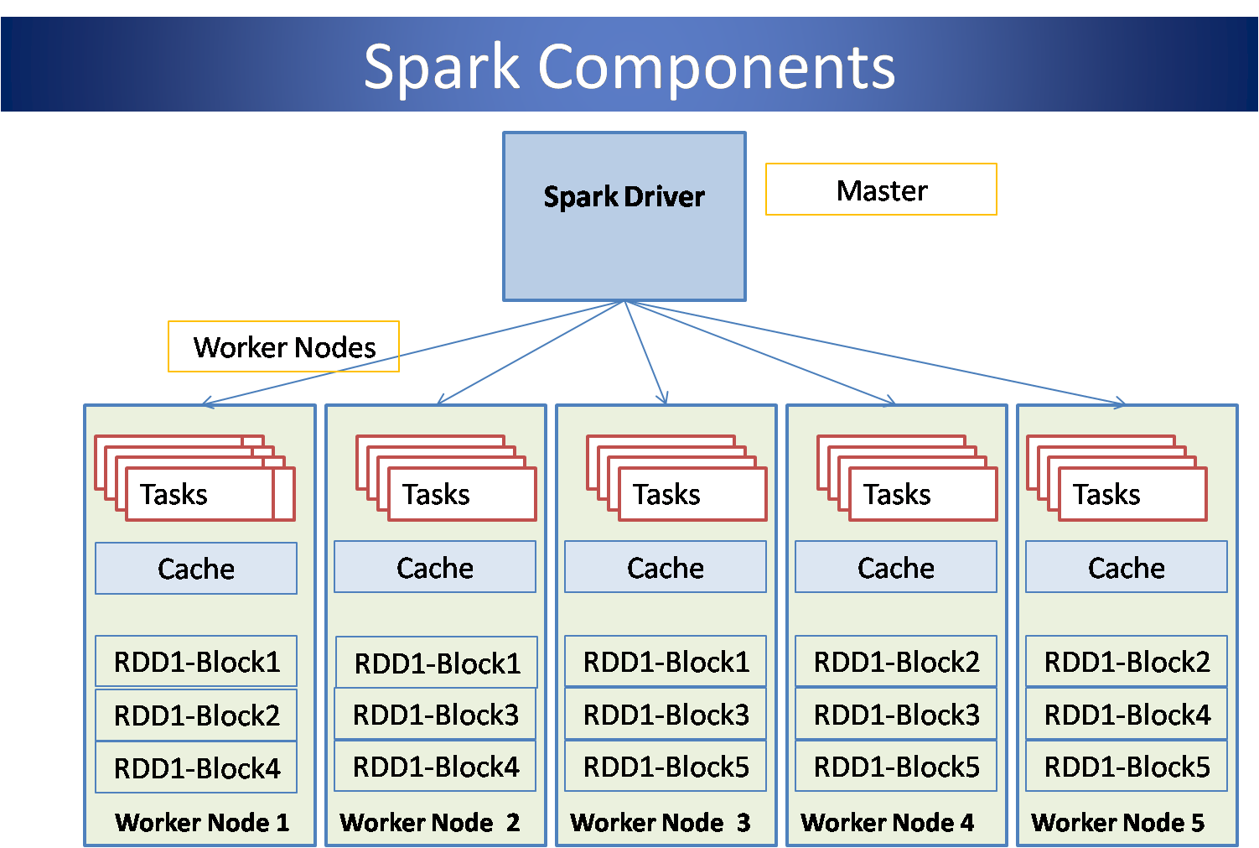

Slide 6
RDD
A Resilient Distributed Dataset (RDD), the basic abstraction in Spark. Represents an immutable, partitioned collection of elements that can be operated on in parallel.
easy to create
transformations:
distinct
filter
map
mapToPair
combineByKey
and many more...
Code

Slide 7
Machine Learning
RDDs, Pipelines, DataFrames
Normalization
TF, TFIDF
naive Bayes, k-means, multilayer perceptron classifier, LDA, random forests...
term frequency representation
normalization
Code

Slide 8
Testing
Does Spark work with testing libraries?
How to test things on spark
The difficulties we have encountered
Due to time restraints we focused primarily on integration and system level tests
Lack of proper documentation makes things difficult
Code

Slide 9
More on Spark
One cannot create and use an RDD within an RDD
Data size may quickly become a problem, it may be required to separate the data into smaller batches
Any files that the program uses must be included in its jar which may cause issues
Code

Slide 10
Results
>>insert result here<<
Prediction

Slide 11
How to start?
www.try.jupyter.org New -> Python 3 (Spark 1.4.1) – no installation, no nothing, it just works!
example code: >>link to the repo<<
or: http://spark.apache.org/downloads.html

